Slide 1
Database Objects
Object | Description
Table | Basic unit of storage; composed of rows
View | Logically represents subsets of data from one or more tables
Sequence | Generates numeric values
Index | Improves the performance of some queries
Synonym | Gives alternative names to objects
Notes:
Database Objects
There are several other objects in a database in addition to tables. In this lesson, you learn about views, sequences, indexes, and synonyms.
With views, you can present and hide data from tables.
Many applications require the use of unique numbers as primary key values. You can either build code into the application to handle this requirement or use a sequence to generate unique numbers.
If you want to improve the performance of some queries, you should consider creating an index. You can also use indexes to enforce uniqueness on a column or a collection of columns.
You can provide alternative names for objects by using synonyms.

Slide 2
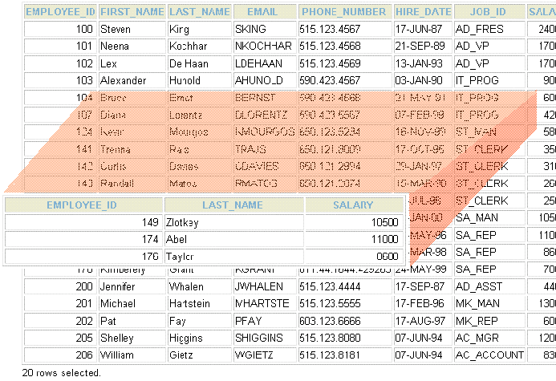
What Is a View?
EMPLOYEES table
Notes:
What Is a View?
You can present logical subsets or combinations of data by creating views of tables. A view is a logical table based on a table or another view. A view contains no data of its own but is like a window through which data from tables can be viewed or changed. The tables on which a view is based are called base tables. The view is stored as a SELECT statement in the data dictionary.

Slide 3

Advantages of Views
To restrict
data access
To make complex queries easy
To provide data independence
To present different views of the same data
Notes:
Advantages of Views
Views restrict access to the data because the view can display selected columns from the table.
Views can be used to make simple queries to retrieve the results of complicated queries. For example, views can be used to query information from multiple tables without the user knowing how to write a join statement.
Views provide data independence for ad hoc users and application programs. One view can be used to retrieve data from several tables.
Views provide groups of users access to data according to their particular criteria.
For more information, see “CREATE VIEW” in the Oracle SQL Reference.

Slide 4
Simple Views and Complex Views
Feature | Simple Views | Complex Views
Number of tables | One | One or more
Contain functions | No | Yes
Contain groups of data | No | Yes
DML operations through a view | Yes | Not always
Notes:
Simple Views and Complex Views
There are two classifications for views: simple and complex. The basic difference is related to the DML (INSERT, UPDATE, and DELETE) operations.
A simple view is one that:
Derives data from only one table
Contains no functions or groups of data
Can perform DML operations through the view
A complex view is one that:
Derives data from many tables
Contains functions or groups of data
Does not always allow DML operations through the view

Slide 5
Creating a View
  You embed a subquery in the CREATE VIEW statement:
  The subquery can contain complex SELECT syntax.
CREATE [OR REPLACE] [FORCE|NOFORCE] VIEW view
[(alias[, alias]...)]
AS subquery
[WITH CHECK OPTION [CONSTRAINT constraint]]
[WITH READ ONLY [CONSTRAINT constraint]];
Notes:
Creating a View
You can create a view by embedding a subquery in the CREATE VIEW statement.
In the syntax:
OR REPLACE re-creates the view if it already exists
FORCE creates the view regardless of whether or not the base tables exist
NOFORCE creates the view only if the base tables exist (This is the default.)
view is the name of the view
alias specifies names for the expressions selected by the view’s query (The number of aliases must match the number of expressions selected by the view.)
subquery is a complete SELECT statement (You can use aliases for the columns in the SELECT list.)
WITH CHECK OPTION specifies that only those rows that are accessible to the view can be inserted or updated
constraint is the name assigned to the CHECK OPTION constraint
WITH READ ONLY ensures that no DML operations can be performed on this view

Slide 6
Creating a View
  Create the EMPVU80 view, which contains details of employees in department 80:
  Describe the structure of the view by using the iSQL*Plus DESCRIBE command:
CREATE VIEW empvu80
AS SELECT employee_id, last_name, salary
FROM employees
WHERE department_id = 80;
View created.
DESCRIBE empvu80
Notes:
Creating a View (continued)
The example in the slide creates a view that contains the employee number, last name, and salary for each employee in department 80.
You can display the structure of the view by using the iSQL*Plus DESCRIBE command.
Guidelines for Creating a View:
The subquery that defines a view can contain complex SELECT syntax, including joins, groups, and subqueries.
If you do not specify a constraint name for a view created with the WITH CHECK OPTION, the system assigns a default name in the format SYS_Cn.
You can use the OR REPLACE option to change the definition of the view without dropping and re-creating it or regranting object privileges previously granted on it.

Slide 7
Creating a View
  Create a view by using column aliases in the subquery:
  Select the columns from this view by the given alias names:
CREATE VIEW salvu50
AS SELECT employee_id ID_NUMBER, last_name NAME,
salary*12 ANN_SALARY
FROM employees
WHERE department_id = 50;
View created.
Notes:
Creating a View (continued)
You can control the column names by including column aliases in the subquery.
The example in the slide creates a view containing the employee number (EMPLOYEE_ID) with the alias ID_NUMBER, name (LAST_NAME) with the alias NAME, and annual salary (SALARY) with the alias ANN_SALARY for every employee in department 50.
As an alternative, you can use an alias after the CREATE statement and prior to the SELECT subquery. The number of aliases listed must match the number of expressions selected in the subquery.
CREATE OR REPLACE VIEW salvu50 (ID_NUMBER, NAME, ANN_SALARY)
AS SELECT employee_id, last_name, salary*12
FROM employees
WHERE department_id = 50;
View created.

Slide 8
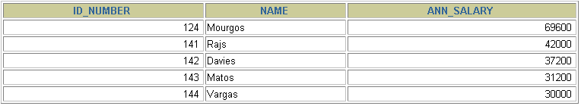
Retrieving Data from a View
SELECT *
FROM salvu50;
Notes:
Retrieving Data from a View
You can retrieve data from a view as you would from any table. You can display either the contents of the entire view or just specific rows and columns.

Slide 9
Modifying a View
  Modify the EMPVU80 view by using a CREATE OR REPLACE VIEW clause. Add an alias for each column name:
  Column aliases in the CREATE OR REPLACE VIEW clause are listed in the same order as the columns in the subquery.
CREATE OR REPLACE VIEW empvu80
(id_number, name, sal, department_id)
AS SELECT employee_id, first_name || ' '
|| last_name, salary, department_id
FROM employees
WHERE department_id = 80;
View created.
Notes:
Modifying a View
With the OR REPLACE option, a view can be created even if one exists with this name already, thus replacing the old version of the view for its owner. This means that the view can be altered without dropping, re-creating, and regranting object privileges.
Note: When assigning column aliases in the CREATE OR REPLACE VIEW clause, remember that the aliases are listed in the same order as the columns in the subquery.

Slide 10
Creating a Complex View
Create a complex view that contains group functions to display values from two tables:
CREATE VIEW dept_sum_vu
(name, minsal, maxsal, avgsal)
AS SELECT d.department_name, MIN(e.salary),
MAX(e.salary),AVG(e.salary)
FROM employees e, departments d
WHERE e.department_id = d.department_id
GROUP BY d.department_name;
View created.
Notes:
Creating a Complex View
The example in the slide creates a complex view of department names, minimum salaries, maximum salaries, and average salaries by department. Note that alternative names have been specified for the view. This is a requirement if any column of the view is derived from a function or an expression.
You can view the structure of the view by using the iSQL*Plus DESCRIBE command. Display the contents of the view by issuing a SELECT statement.
SELECT *
FROM dept_sum_vu;

Slide 11


Rules for Performing
DML Operations on a View
  You can usually perform DML operations
  on simple views.
  You cannot remove a row if the view contains the following:
    Group functions
    A GROUP BY clause
    The DISTINCT keyword
    The pseudocolumn ROWNUM keyword
Notes:
Performing DML Operations on a View
You can perform DML operations on data through a view if those operations follow certain rules.
You can remove a row from a view unless it contains any of the following:
Group functions
A GROUP BY clause
The DISTINCT keyword
The pseudocolumn ROWNUM keyword

Slide 12
Rules for Performing
DML Operations on a View
You cannot modify data in a view if it contains:
  Group functions
  A GROUP BY clause
  The DISTINCT keyword
  The pseudocolumn ROWNUM keyword
  Columns defined by expressions
Notes:
Performing DML Operations on a View (continued)
You can modify data through a view unless it contains any of the conditions mentioned in the previous slide or columns defined by expressions (for example, SALARY * 12).

Slide 13
Removing a View
You can remove a view without losing data because a view is based on underlying tables in the database.
DROP VIEW view;
DROP VIEW empvu80;
View dropped.
Notes:
Removing a View
You use the DROP VIEW statement to remove a view. The statement removes the view definition from the database. Dropping views has no effect on the tables on which the view was based. Views or other applications based on deleted views become invalid. Only the creator or a user with the DROP ANY VIEW privilege can remove a view.
In the syntax:
view is the name of the view

Slide 14
Sequences
Object | Description
Table | Basic unit of storage; composed of rows
View | Logically represents subsets of data from one or more tables
Sequence | Generates numeric values
Index | Improves the performance of some queries
Synonym | Gives alternative names to objects
Notes:
Sequences
A sequence is a database object that creates integer values. You can create sequences and then use them to generate numbers.

Slide 15

Sequences
A sequence:
  Can automatically generate unique numbers
  Is a sharable object
  Can be used to create a primary key value
  Replaces application code
  Speeds up the efficiency of accessing sequence values when cached in memory
2
4
6
8
10
1
3
5
7
9
Notes:
Sequences
A sequence is a user-created database object that can be shared by multiple users to generate integers.
You can define a sequence to generate unique values or to recycle and use the same numbers again.
A typical usage for sequences is to create a primary key value, which must be unique for each row. The sequence is generated and incremented (or decremented) by an internal Oracle routine. This can be a time-saving object because it can reduce the amount of application code needed to write a sequence-generating routine.
Sequence numbers are stored and generated independently of tables. Therefore, the same sequence can be used for multiple tables.

Slide 16
CREATE SEQUENCE Statement:
Syntax
Define a sequence to generate sequential numbers automatically:
CREATE SEQUENCE sequence
[INCREMENT BY n]
[START WITH n]
[{MAXVALUE n | NOMAXVALUE}]
[{MINVALUE n | NOMINVALUE}]
[{CYCLE | NOCYCLE}]
[{CACHE n | NOCACHE}];
Notes:
Creating a Sequence
Automatically generate sequential numbers by using the CREATE SEQUENCE statement.
In the syntax:
sequence is the name of the sequence generator
INCREMENT BY n specifies the interval between sequence numbers, where n is an integer (If this clause is omitted, the sequence increments by 1.)
START WITH n specifies the first sequence number to be generated (If this clause is omitted, the sequence starts with 1.)
MAXVALUE n specifies the maximum value the sequence can generate
NOMAXVALUE specifies a maximum value of 10^27 for an ascending sequence and –1 for a descending sequence (This is the default option.)
MINVALUE n specifies the minimum sequence value
NOMINVALUE specifies a minimum value of 1 for an ascending sequence and –(10^26) for a descending sequence (This is the default option.)

Slide 17
Creating a Sequence
  Create a sequence named DEPT_DEPTID_SEQ to be used for the primary key of the DEPARTMENTS table.
  Do not use the CYCLE option.
CREATE SEQUENCE dept_deptid_seq
INCREMENT BY 10
START WITH 120
MAXVALUE 9999
NOCACHE
NOCYCLE;
Sequence created.
Notes:
Creating a Sequence (continued)
CYCLE | NOCYCLE specifies whether the sequence continues to generate values after reaching its maximum or minimum value (NOCYCLE is the default option.)
CACHE n | NOCACHE specifies how many values the Oracle server preallocates and keeps in memory (By default, the Oracle server caches 20 values.)
The example in the slide creates a sequence named DEPT_DEPTID_SEQ to be used for the DEPARTMENT_ID column of the DEPARTMENTS table. The sequence starts at 120, does not allow caching, and does not cycle.
Do not use the CYCLE option if the sequence is used to generate primary key values, unless you have a reliable mechanism that purges old rows faster than the sequence cycles.
For more information, see “CREATE SEQUENCE” in the Oracle SQL Reference.
Note: The sequence is not tied to a table. Generally, you should name the sequence after its intended use. However, the sequence can be used anywhere, regardless of its name.

Slide 18
NEXTVAL and CURRVAL Pseudocolumns
  NEXTVAL returns the next available sequence value. It returns a unique value every time it is referenced, even for different users.
  CURRVAL obtains the current sequence value.
  NEXTVAL must be issued for that sequence before CURRVAL contains a value.
Notes:
NEXTVAL and CURRVAL Pseudocolumns
After you create your sequence, it generates sequential numbers for use in your tables. Reference the sequence values by using the NEXTVAL and CURRVAL pseudocolumns.
The NEXTVAL pseudocolumn is used to extract successive sequence numbers from a specified sequence. You must qualify NEXTVAL with the sequence name. When you reference sequence.NEXTVAL, a new sequence number is generated and the current sequence number is placed in CURRVAL.
The CURRVAL pseudocolumn is used to refer to a sequence number that the current user has just generated. NEXTVAL must be used to generate a sequence number in the current user’s session before CURRVAL can be referenced. You must qualify CURRVAL with the sequence name. When you reference sequence.CURRVAL, the last value returned to that user’s process is displayed.

Slide 19
Using a Sequence
  Insert a new department named “Support” in location ID 2500:
  View the current value for the DEPT_DEPTID_SEQ sequence:
INSERT INTO departments(department_id,
department_name, location_id)
VALUES (dept_deptid_seq.NEXTVAL,
'Support', 2500);
1 row created.
SELECT dept_deptid_seq.CURRVAL
FROM dual;
Notes:
Using a Sequence
The example in the slide inserts a new department in the DEPARTMENTS table. It uses the DEPT_DEPTID_SEQ sequence to generate a new department number as follows.
You can view the current value of the sequence:
SELECT dept_deptid_seq.CURRVAL
FROM dual;
Suppose that you now want to hire employees to staff the new department. The INSERT statement to be executed for all new employees can include the following code:
INSERT INTO employees (employee_id, department_id, ...)
VALUES (employees_seq.NEXTVAL, dept_deptid_seq .CURRVAL, ...);
Note: The preceding example assumes that a sequence called EMPLOYEE_SEQ has already been created to generate new employee numbers.

Slide 20
Caching Sequence Values
  Caching sequence values in memory gives faster access to those values.
  Gaps in sequence values can occur when:
    A rollback occurs
    The system crashes
    A sequence is used in another table
Notes:
Caching Sequence Values
You can cache sequences in memory to provide faster access to those sequence values. The cache is populated the first time you refer to the sequence. Each request for the next sequence value is retrieved from the cached sequence. After the last sequence value is used, the next request for the sequence pulls another cache of sequences into memory.
Gaps in the Sequence
Although sequence generators issue sequential numbers without gaps, this action occurs independent of a commit or rollback. Therefore, if you roll back a statement containing a sequence, the number is lost.
Another event that can cause gaps in the sequence is a system crash. If the sequence caches values in memory, then those values are lost if the system crashes.
Because sequences are not tied directly to tables, the same sequence can be used for multiple tables. If you do so, each table can contain gaps in the sequential numbers.

Slide 21
Modifying a Sequence
Change the increment value, maximum value, minimum value, cycle option, or cache option:
ALTER SEQUENCE dept_deptid_seq
INCREMENT BY 20
MAXVALUE 999999
NOCACHE
NOCYCLE;
Sequence altered.
Notes:
Modifying a Sequence
If you reach the MAXVALUE limit for your sequence, no additional values from the sequence are allocated and you will receive an error indicating that the sequence exceeds the MAXVALUE. To continue to use the sequence, you can modify it by using the ALTER SEQUENCE statement.
Syntax
ALTER SEQUENCE sequence
[INCREMENT BY n]
[{MAXVALUE n | NOMAXVALUE}]
[{MINVALUE n | NOMINVALUE}]
[{CYCLE | NOCYCLE}]
[{CACHE n | NOCACHE}];
In the syntax, sequence is the name of the sequence generator.
For more information, see “ALTER SEQUENCE” in the Oracle SQL Reference.

Slide 22
Guidelines for Modifying a Sequence
  You must be the owner or have the ALTER privilege for the sequence.
  Only future sequence numbers are affected.
  The sequence must be dropped and
  re-created to restart the sequence at a different number.
  Some validation is performed.
  To remove a sequence, use the DROP statement:
DROP SEQUENCE dept_deptid_seq;
Sequence dropped.
Notes:
Guidelines for Modifying a Sequence
You must be the owner or have the ALTER privilege for the sequence to modify it. You must be the owner or have the DROP ANY SEQUENCE privilege to remove it.
Only future sequence numbers are affected by the ALTER SEQUENCE statement.
The START WITH option cannot be changed using ALTER SEQUENCE. The sequence must be dropped and re-created to restart the sequence at a different number.
Some validation is performed. For example, a new MAXVALUE that is less than the current sequence number cannot be imposed.
ALTER SEQUENCE dept_deptid_seq
INCREMENT BY 20
MAXVALUE 90
NOCACHE
NOCYCLE;
ALTER SEQUENCE dept_deptid_seq
*
ERROR at line 1:
ORA-04009: MAXVALUE cannot be made to be less than the current value

Slide 23
Indexes
Object | Description
Table | Basic unit of storage; composed of rows
View | Logically represents subsets of data from one or more tables
Sequence | Generates numeric values
Index | Improves the performance of some queries
Synonym | Gives alternative names to objects
Notes:
Indexes
Indexes are database objects that you can create to improve the performance of some queries. Indexes can also be created automatically by the server when you create a primary key or unique constraint.

Slide 24

Indexes
An index:
  Is a schema object
  Is used by the Oracle server to speed up the retrieval of rows by using a pointer
  Can reduce disk I/O by using a rapid path access method to locate data quickly
  Is independent of the table that it indexes
  Is used and maintained automatically by the Oracle server
Notes:
Indexes (continued)
An Oracle server index is a schema object that can speed up the retrieval of rows by using a pointer. Indexes can be created explicitly or automatically. If you do not have an index on the column, then a full table scan occurs.
An index provides direct and fast access to rows in a table. Its purpose is to reduce the necessity of disk I/O by using an indexed path to locate data quickly. The index is used and maintained automatically by the Oracle server. After an index is created, no direct activity is required by the user.
Indexes are logically and physically independent of the table that they index. This means that they can be created or dropped at any time and have no effect on the base tables or other indexes.
Note: When you drop a table, corresponding indexes are also dropped.
For more information, see “Schema Objects: Indexes” in Database Concepts.

Slide 25


How Are Indexes Created?
  Automatically: A unique index is created automatically when you define a PRIMARY KEY or UNIQUE constraint in a table definition.
  Manually: Users can create nonunique indexes on columns to speed up access to the rows.
Notes:
Types of Indexes
Two types of indexes can be created.
Unique index: The Oracle server automatically creates this index when you define a column in a table to have a PRIMARY KEY or a UNIQUE key constraint. The name of the index is the name that is given to the constraint.
Nonunique index: This is an index that a user can create. For example, you can create a FOREIGN KEY column index for a join in a query to improve retrieval speed.
Note: You can manually create a unique index, but it is recommended that you create a unique constraint, which implicitly creates a unique index.

Slide 26
Creating an Index
  Create an index on one or more columns:
  Improve the speed of query access to the LAST_NAME column in the EMPLOYEES table:
CREATE INDEX index
ON table (column[, column]...);
CREATE INDEX emp_last_name_idx
ON employees(last_name);
Index created.
Notes:
Creating an Index
Create an index on one or more columns by issuing the CREATE INDEX statement.
In the syntax:
index is the name of the index
table is the name of the table
column is the name of the column in the table to be indexed
For more information, see “CREATE INDEX” in the Oracle SQL Reference.

Slide 27
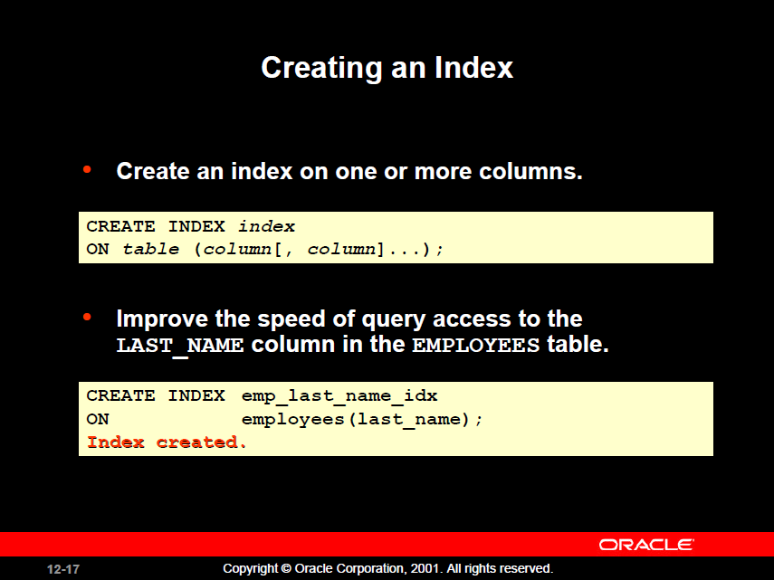


Slide 28
Types of Index
1.Simple Index
An index created on a single column of a table is called simple index.
2.Composit Index
An index created on more than one column is called a composit Index

Slide 29
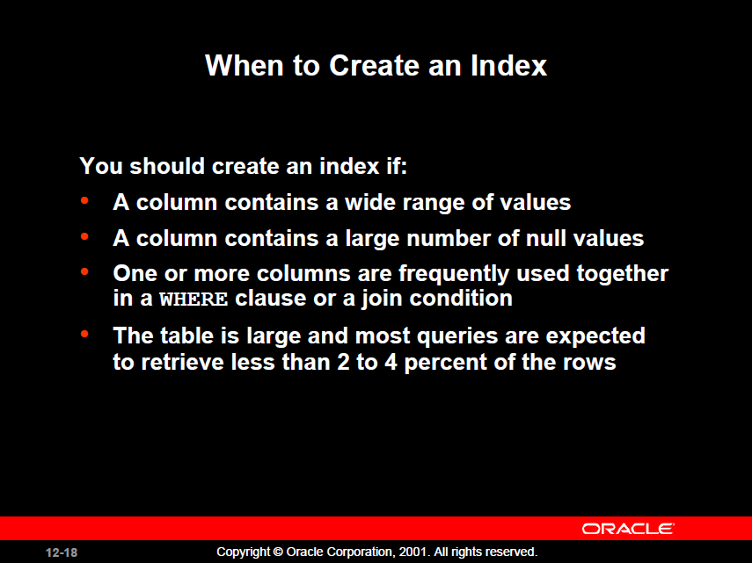

Slide 30
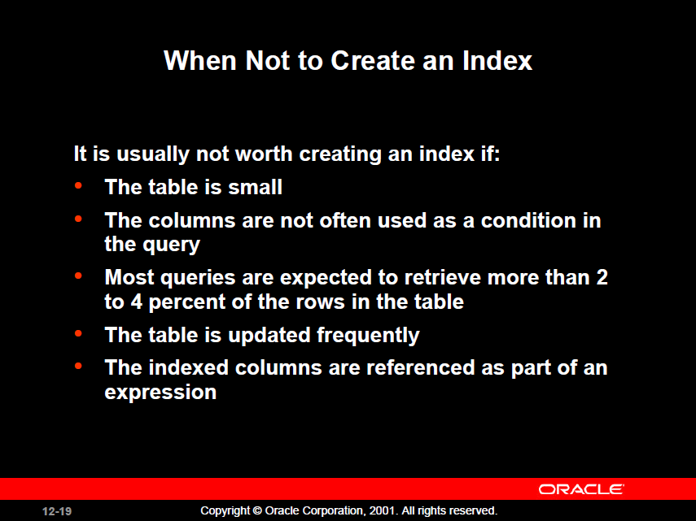

Slide 31
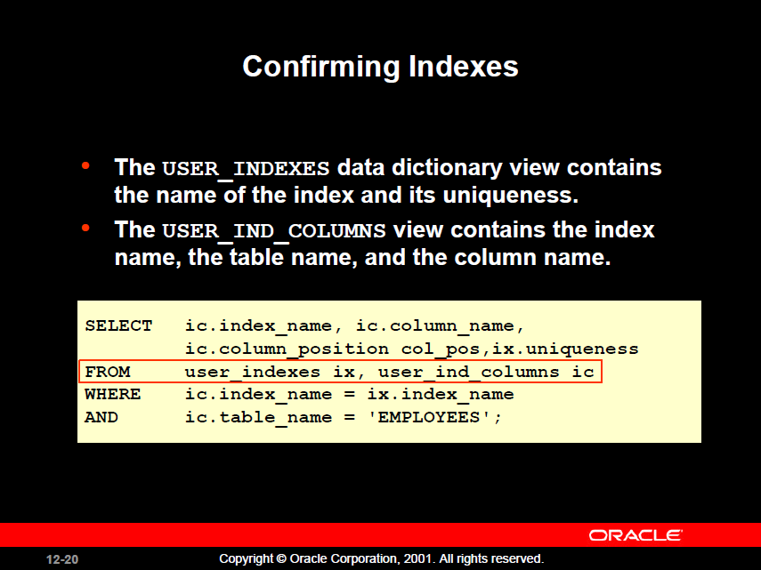

Slide 32
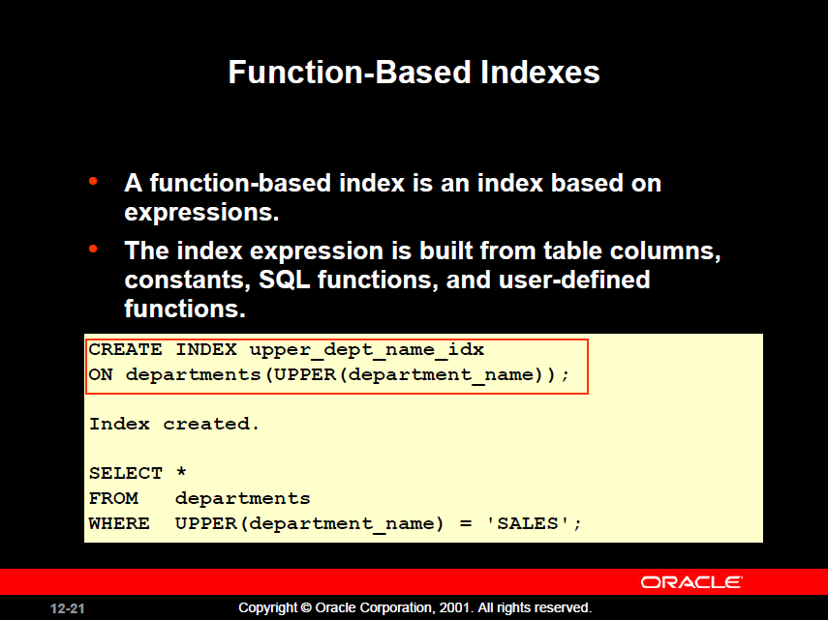

Slide 33
Index Creation Guidelines
Create an index when:
 | A column contains a wide range of values
 | A column contains a large number of null values
 | One or more columns are frequently used together in a WHERE clause or a join condition
 | The table is large and most queries are expected to retrieve less than 2% to 4% of the rows in the table
Do not create an index when:
 | The columns are not often used as a condition in the query
 | The table is small or most queries are expected to retrieve more than 2% to 4% of the rows in the table
 | The table is updated frequently
 | The indexed columns are referenced as part of an expression
Notes:
More Is Not Always Better
Having more indexes on a table does not produce faster queries. Each DML operation that is committed on a table with indexes means that the indexes must be updated. The more indexes that you have associated with a table, the more effort the Oracle server must make to update all the indexes after a DML operation.
When to Create an Index
Therefore, you should create indexes only if:
The column contains a wide range of values
The column contains a large number of null values
One or more columns are frequently used together in a WHERE clause or join condition
The table is large and most queries are expected to retrieve less than 2% to 4% of the rows
Remember that if you want to enforce uniqueness, you should define a unique constraint in the table definition. A unique index is then created automatically.

Slide 34
Removing an Index
  Remove an index from the data dictionary by using the DROP INDEX command:
  Remove the UPPER_LAST_NAME_IDX index from the data dictionary:
  To drop an index, you must be the owner of the index or have the DROP ANY INDEX privilege.
DROP INDEX index;
DROP INDEX emp_last_name_idx;
Index dropped.
Notes:
Removing an Index
You cannot modify indexes. To change an index, you must drop it and then re-create it.
Remove an index definition from the data dictionary by issuing the DROP INDEX statement. To drop an index, you must be the owner of the index or have the DROP ANY INDEX privilege.
In the syntax, index is the name of the index.
Note: If you drop a table, indexes and constraints are automatically dropped but views and sequences remain.

Slide 35
Synonyms
Object | Description
Table | Basic unit of storage; composed of rows
View | Logically represents subsets of data from one or more tables
Sequence | Generates numeric values
Index | Improves the performance of some queries
Synonym | Gives alternative names to objects
Notes:
Synonyms
Synonyms are database objects that enable you to call a table by another name. You can create synonyms to give an alternate name to a table.

Slide 36
Synonyms
Simplify access to objects by creating a synonym (another name for an object). With synonyms, you can:
  Create an easier reference to a table that is owned by another user
  Shorten lengthy object names
CREATE [PUBLIC] SYNONYM synonym
FOR object;
Notes:
Creating a Synonym for an Object
To refer to a table that is owned by another user, you need to prefix the table name with the name of the user who created it, followed by a period. Creating a synonym eliminates the need to qualify the object name with the schema and provides you with an alternative name for a table, view, sequence, procedure, or other objects. This method can be especially useful with lengthy object names, such as views.
In the syntax:
PUBLIC creates a synonym that is accessible to all users
synonym is the name of the synonym to be created
object identifies the object for which the synonym is created
Guidelines
The object cannot be contained in a package.
A private synonym name must be distinct from all other objects that are owned by the same user.
For more information, see “CREATE SYNONYM” in the Oracle SQL Reference.

Slide 37
Creating and Removing Synonyms
  Create a shortened name for the DEPT_SUM_VU view:
  Drop a synonym:
CREATE SYNONYM d_sum
FOR dept_sum_vu;
Synonym Created.
DROP SYNONYM d_sum;
Synonym dropped.
Notes:
Creating a Synonym
The slide example creates a synonym for the DEPT_SUM_VU view for quicker reference.
The database administrator can create a public synonym that is accessible to all users. The following example creates a public synonym named DEPT for Alice’s DEPARTMENTS table:
CREATE PUBLIC SYNONYM dept
FOR alice.departments;
Synonym created.
Removing a Synonym
To remove a synonym, use the DROP SYNONYM statement. Only the database administrator can drop a public synonym.
DROP PUBLIC SYNONYM dept;
Synonym dropped.
For more information, see “DROP SYNONYM” in the Oracle SQL Reference.

Slide 38
Summary
In this lesson, you should have learned how to:
  Create, use, and remove views
  Automatically generate sequence numbers by using a sequence generator
  Create indexes to improve query retrieval speed
  Use synonyms to provide alternative names for objects
Notes:
Summary
In this lesson, you should have learned about database objects such as views, sequences, indexes, and synonyms.

